Slide 1
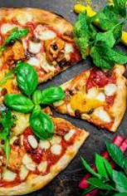
The Battle of the Neighborhoods
Pizza places in Selangor and kuala lumpur

Slide 2
Problem Statement
What is the distribution of pizza places in Selangor and Kuala Lumpur (referred to as “my hometown” from now on); and
Where would be the best location to open a new pizza place in my hometown.

Slide 3
Target audience
Myself. I travel a lot within my hometown for my work., therefore, the result of this project should improve my pizza meal choices moving forward.
Existing and future restaurant owners. The project should somewhat benefit this group. Food & beverage industry is very competitive, particularly for Western cuisine restaurants. A Southeast Asian country, rice-based meals are the preferred option for the locals, hence, location is a critical factor for Western cuisine restaurants.

Slide 4
Data selection
List of neighborhoods in my hometown
No known single source, hence, we will be using these sources from Wikipedia:
• https://en.wikipedia.org/wiki/Category:Townships_in_Selangor; and
• https://en.wikipedia.org/wiki/Category:Suburbs_in_Kuala_Lumpur
Coordinates of the listed neighborhoods
Python Geocoder package should be able to provide us with the latitude and longitude of the listed neighborhoods.
List of pizza places in the listed neighborhoods
Foursquare API will be utilized as datasource, which should be able to provide to us with all kind of information in relation to venues, which include but not limited to venue name, category, menu, as well as location. Particularly, “Pizza Places” should be available as part of the information.

Slide 5
Data selection
List of neighborhoods in my hometown
No known single source, hence, we will be using these sources from Wikipedia:
• https://en.wikipedia.org/wiki/Category:Townships_in_Selangor; and
• https://en.wikipedia.org/wiki/Category:Suburbs_in_Kuala_Lumpur
Coordinates of the listed neighborhoods
Python Geocoder package should be able to provide us with the latitude and longitude of the listed neighborhoods.
List of pizza places in the listed neighborhoods
Foursquare API will be utilized as datasource, which should be able to provide to us with all kind of information in relation to venues, which include but not limited to venue name, category, menu, as well as location. Particularly, “Pizza Places” should be available as part of the information.
For step-by-step methodology, refer to Report and/or notebook in Github.

Slide 6
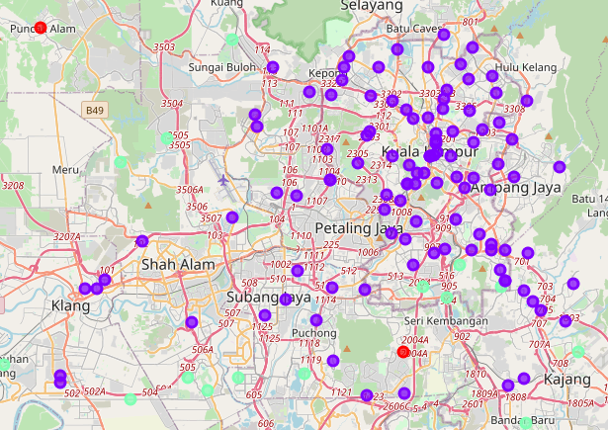
Observations
Cluster | Description | Colour
0 | Zero to low concentration of pizza places
1 | Medium concentration of pizza places
2 | High concentration of pizza places
Most of the neighborhoods within my hometown are in cluster 0.
An interesting observation, even for affluent neighborhoods such as the ones within Kuala Lumpur, have zero or low concentration of pizza places.
Only 3 neighbourhoods – Puncak Alam, Puncak Jalil, and Bukit Beruntung – has high concentration of pizza places.
A quick glance show that these neighbourhoods are pretty secluded and do not have much competition in food & beverage industry.

Slide 7
Discussion and conclusion
The result is still preliminary. The result could mean that there is a good prospect for a pizza place practically anywhere in my hometown. On the other hand, it could also mean that pizza is not really chosen food for Malaysians to dine.
Refining the result would require data on population as well as income level per capita for each neighborhood. Additionally, the project can also benefit by further segregating fast food pizza as well as gourmet pizza restaurants to provide better clarity to target audience.
The result of the project confirmed my hypothesis that there aren’t many pizza places in my hometown – a sad observation indeed.
The lack of pizza places could be a missed opportunity by restaurateurs in these neighborhoods, which in my opinion, should be affluent and modern enough to have pizza more frequently.
Further evaluation and refinement is necessary to further evaluate the rationale behind this finding.

Slide 8
THANK YOU

